Slide 1



PIMA INDIANS-PREDICT THE ONSET OF DIABETES
Author : Saurabh Anand Date: Nov, 15 2017

Slide 2
Contents
Introduction
Background on diabetes and description
Target Audience
Data Acquisition- Small Dataset! Why?
Data Description
Data Wrangling
Exploratory Data Analysis
Machine Learning Algorithms
Result Summary and Conclusion

Slide 3

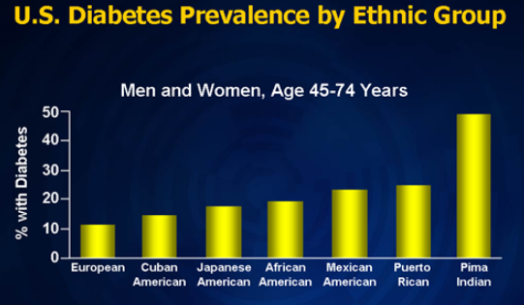
Background and Description
Background
Diabetes is a group of metabolic diseases in which there are high blood
sugar levels over a prolonged period
Description
Project emphasizes on onset of diabetes in Pima Indians
Dataset gathered from UCI ML repository
Data content of at least 21 yr old female of Pima Indian heritage
Depicts the onset of diabetes in various ethnic group in US,
Pima Indians being the highest

Slide 4
Contents
Introduction
Background on diabetes and description
Objective and Target Audience
Data Acquisition- Small Dataset! Why?
Data Description
Data Wrangling
Exploratory Data Analysis
Machine Learning Algorithms
Result Summary and Conclusion

Slide 5
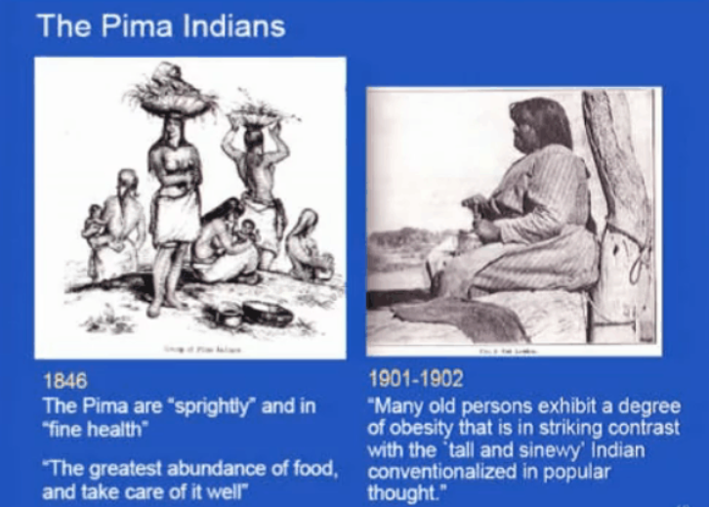
Objective and Target Audience
Objective
Final objective of the analysis is to make predictions on whether a person is to suffer the diabetes given the features in the dataset by determining the accuracy using various Machine learning models
PIMA Indians Female diabetics-
768 Female diabetics patient info in dataset
Predict the probability that individual females have diabetes
Detect subgroups of characteristics that are at higher risk of diabetes

Slide 6
Contents
Introduction
Background on diabetes and description
Target Audience
Data Acquisition- Small Dataset! Why?
Data Description
Data Wrangling
Exploratory Data Analysis
Machine Learning Algorithms
Result Summary and Conclusion

Slide 7
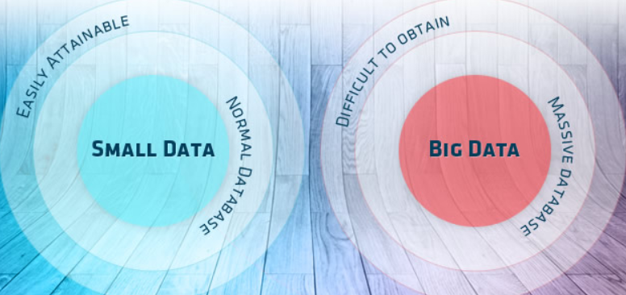
Data Acquisition- Small dataset! Why?
Dataset for 768 patients with 9 variables
Researcher argued “the sample size is small, the form of underlying functional relationship is not known, and the underlying functional relationships involve complex interactions and inter correlations among a number of variables“
Dataset to understand the correlations among number of variables using various machine learning models.

Slide 8
Contents
Introduction
Background on diabetes and description
Target Audience
Data Acquisition- Small Dataset! Why?
Data Description
Data Wrangling
Exploratory Data Analysis
Machine Learning Algorithms
Result Summary and Conclusion

Slide 9
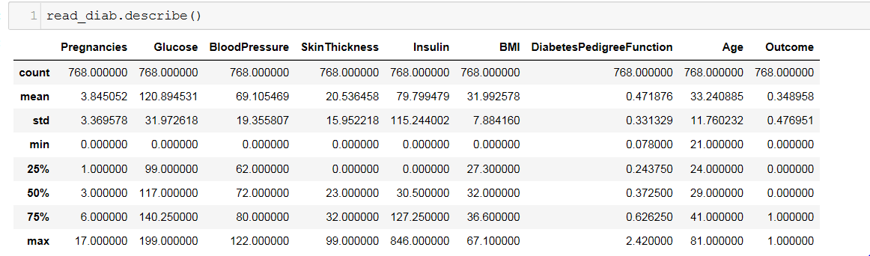
Data Description
Dataset for 768 patients with 9 variables
Pregnancies: Number of times pregnant
Glucose: Plasma glucose concentration a 2 hours in an oral glucose tolerance test
Blood Pressure: Diastolic blood pressure (mm Hg)
Skin Thickness: Triceps skin fold thickness (mm)
Insulin: 2-Hour serum insulin (mu U/ml)
BMI: Body mass index (weight in kg/(height in m)^2)
Diabetes Pedigree Function
Age: Age (years)
Outcome: Class variable (0 or 1)

Slide 10
Contents
Introduction
Background on diabetes and description
Target Audience
Data Acquisition- Small Dataset! Why?
Data Description
Data Wrangling
Exploratory Data Analysis
Machine Learning Algorithms
Result Summary and Conclusion

Slide 11
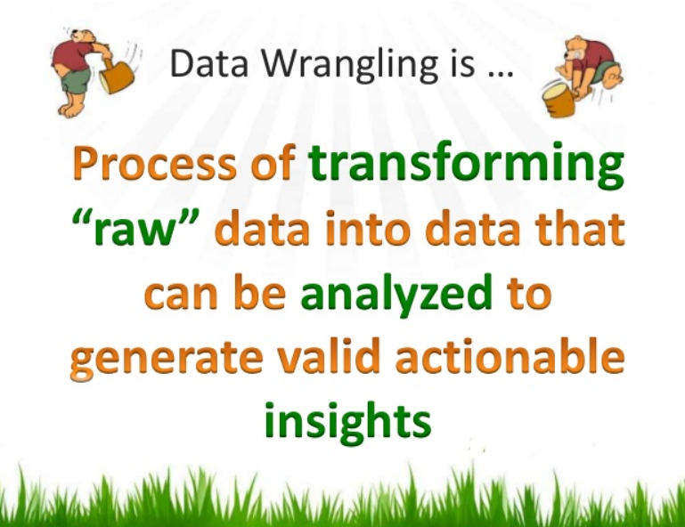
Data Wrangling
Steps performed-
CSV files was loaded with 768 records
Validated shape of the data
500 negative instances (65.1%) and 258 positive instances (34.9%) was found
Some attributes where a zero value exist seem to be errors in the data (e.g. Glucose, BMI and blood pressure)
Filled in missing values, mostly ‘0’ observed for Glucose, BMI and blood pressure. To fill in missing values, mode was used for each attributes for better analysis purpose.

Slide 12
Contents
Introduction
Background on diabetes and description
Target Audience
Data Acquisition- Small Dataset! Why?
Data Description
Data Wrangling
Exploratory Data Analysis
Machine Learning Algorithms
Result Summary and Conclusion

Slide 13
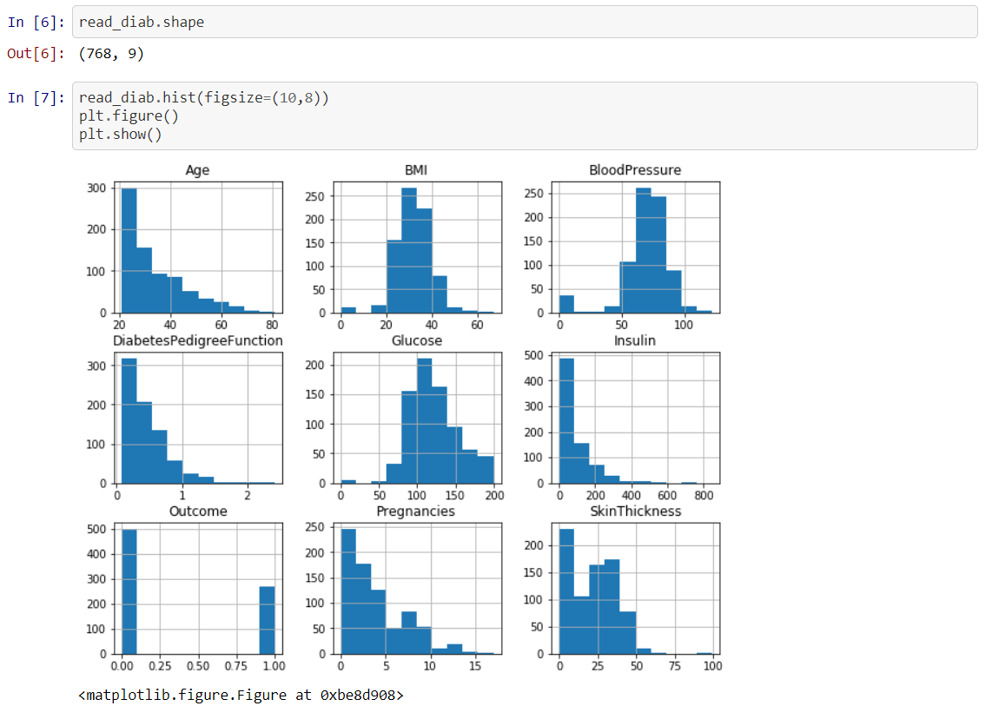
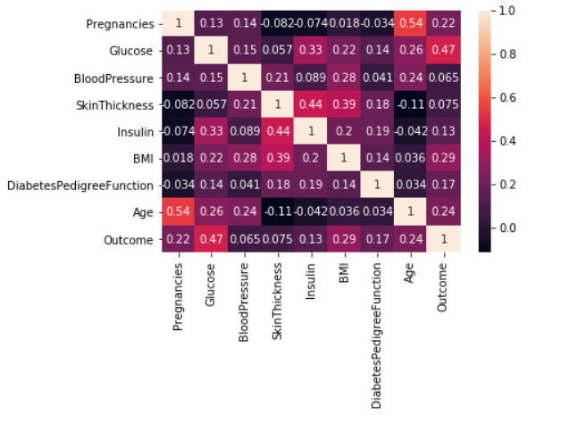
Exploratory Data Analysis
Most of the initial data analysis was regarding the shape of the dataset and exploration of each attributes in the data.

Slide 14
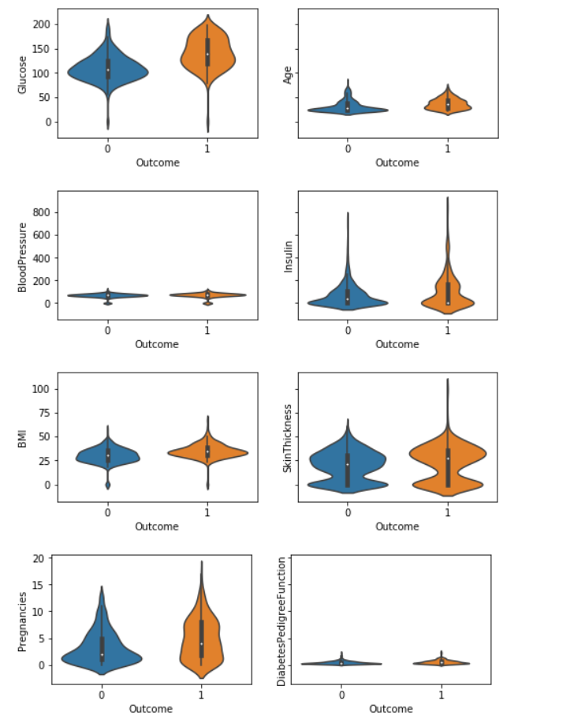
Exploratory Data Analysis(Contd)
Inference-
Graph shows that the glucose ranges from 44 to 200 and there isn't much difference on outcome comparison.
But age and outcome comparison shows that the aged person are there who has '0' outcomes which helps to draw the thought that there is more chances of diabetes among young group of Pima Indians females.
Insulin level shows that person having onset of diabetes has high insulin level.
Also there seems to be an outlier in skin thickness for people having positive outcome.
Looking onto pregnancies plot it seems like there are more pregnant Pima Indian females which has onset of diabetes.
Seems to be no obvious relationship between age and onset of diabetes.
Seems no obvious relationship between pedigree function and onset of diabetes.
It suggest that diabetes is not hereditary, or that the Diabetes Pedigree Function needs work

Slide 15
Contents
Introduction
Background on diabetes and description
Target Audience
Data Acquisition- Small Dataset! Why?
Data Description
Data Wrangling
Exploratory Data Analysis
Machine Learning Algorithms
Result Summary and Conclusion

Slide 16
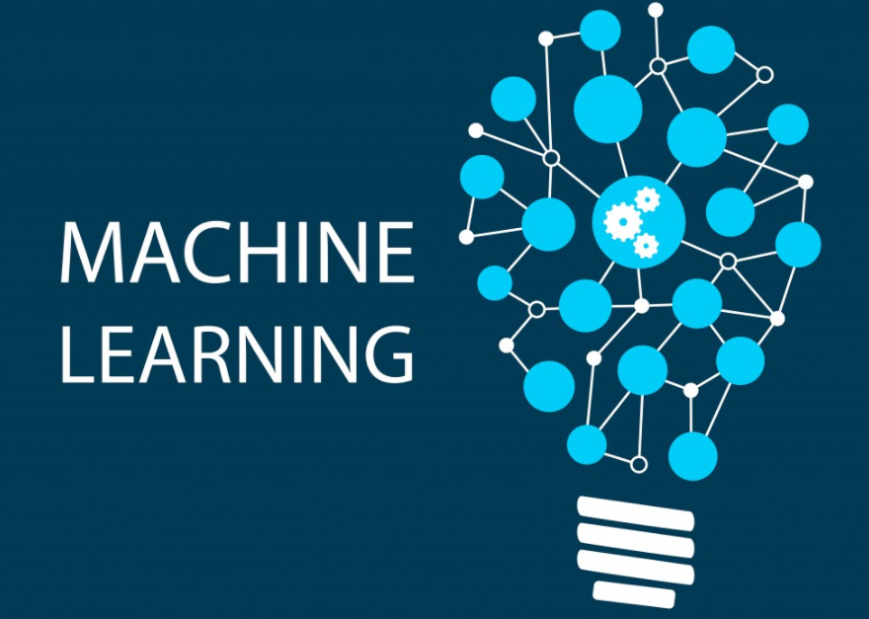
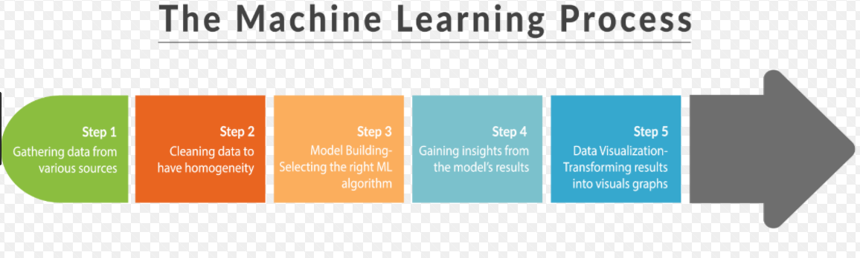
Machine Learning
For this study, we’ll take a look at the performance of below algorithms:
Logistics Regression
Linear Discriminant Analysis
K-Nearest Neighbor
Decisions Tree Classifier
Random Forest
Gaussian Naive Bayes
Support Vector Machines

Slide 17
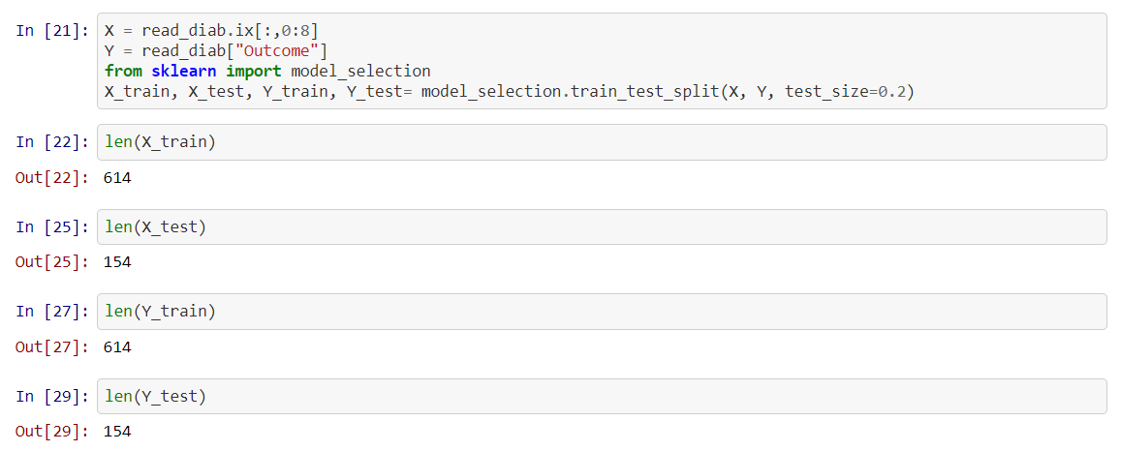
Machine Learning(Contd)- 80:20(Train and Test Split)
The primary goal of the machine learning (ML) section is to identify the best algorithm to predict the accuracy of onset of diabetes with various ML models
For validating the accuracy through each ML model, data has been split into Train and Test (80:20)

Slide 18
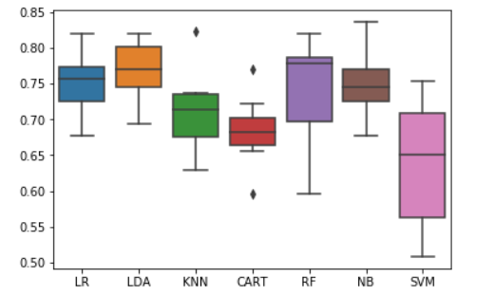
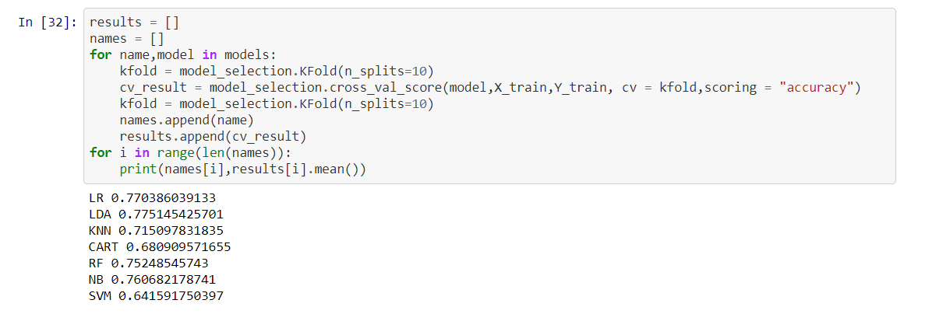
Machine Learning(Contd)- 80:20 (Train and Test Split)
ML algorithm was applied first on train data and the depending upon the performance of the model, test data was fit to validate the accuracy.

Slide 19
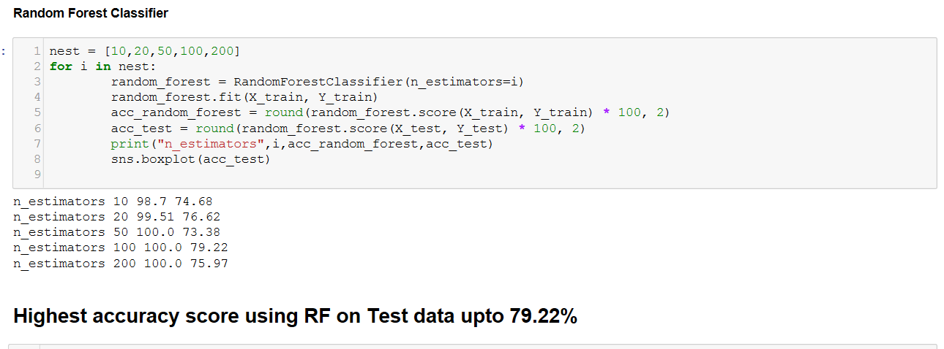
Machine Learning(Contd)-Test data fit
Based on above visualization, as these are above 75% accuracy, so I planned to fit test data into LR, LDA and RF model. Out of all best performance comes out from Random forest classifier model.

Slide 20
Contents
Introduction
Background on diabetes and description
Target Audience
Data Acquisition- Small Dataset! Why?
Data Description
Data Wrangling
Exploratory Data Analysis
Machine Learning Algorithms
Result Summary and Conclusion

Slide 21

Result Summary and Conclusion
After performing a cross-validation on the dataset, I focused on analyzing the algorithms which has more accuracy.
Based on testing, accuracy will determine the percentage of instances that were correctly classified by the algorithm. This was an important start of my analysis since gave me a baseline of how each algorithm performs.
I believe it was very interesting to see how our algorithms predict on this scale.
The data here suggests that Logistic Regression, LDA and RF performs the best on the standard, while other performed comparatively low. However, there is no clear winner between any of the algorithms.
I strongly believe that all algorithms will perform rather similarly because we are dealing with a small dataset for classification. However, the 3 algorithms should all perform better than the class baseline prediction that gave an accuracy above 75%.

Slide 22


